Slide 1
Consumer Financial Canvas
A decision model to help students make well-considered choices
Theo Roos

Slide 2
History
Our course was mentioned Management & Organisation
In 2014 a new programme for our course was announced
Business economics, entrepreneurship and financial self sufficiency, mostly referred to as financial literacy
New subjects were entered
Change to a preparing for higher education course

Slide 3
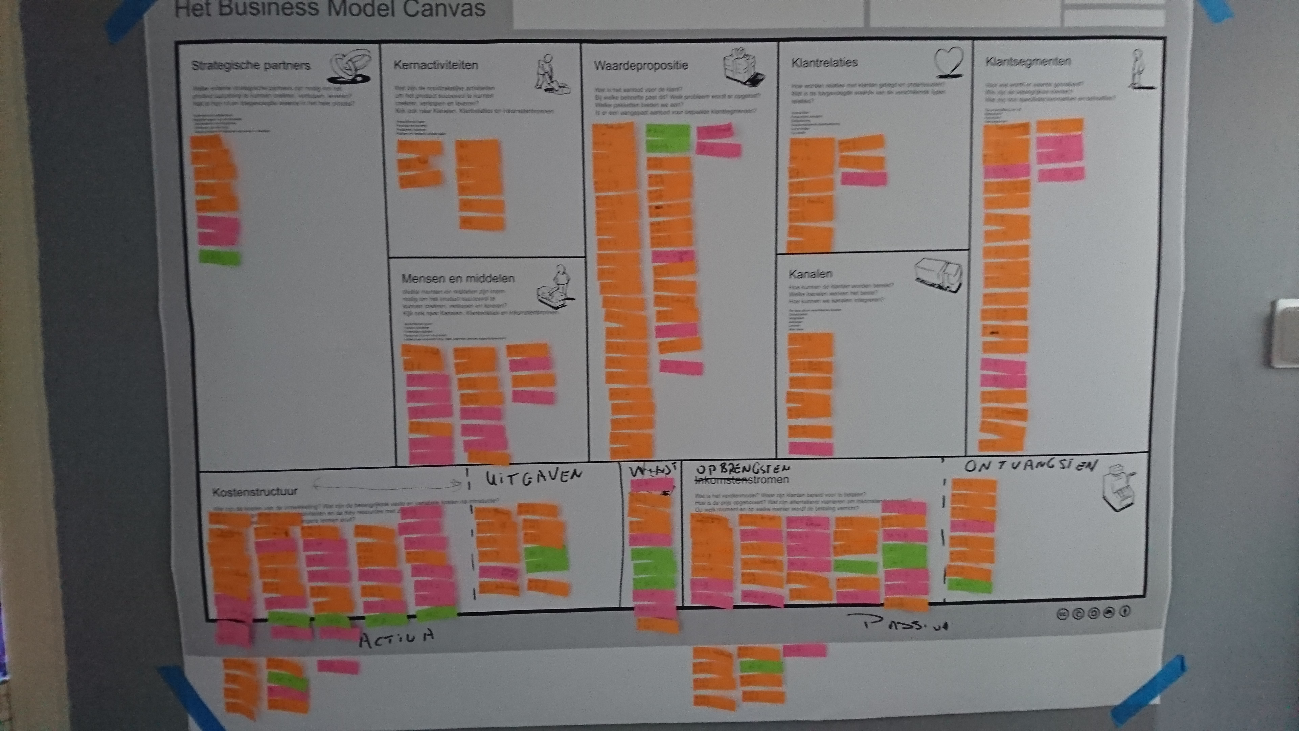

Working with models
Education team for the new subjects
Working with models

Slide 4
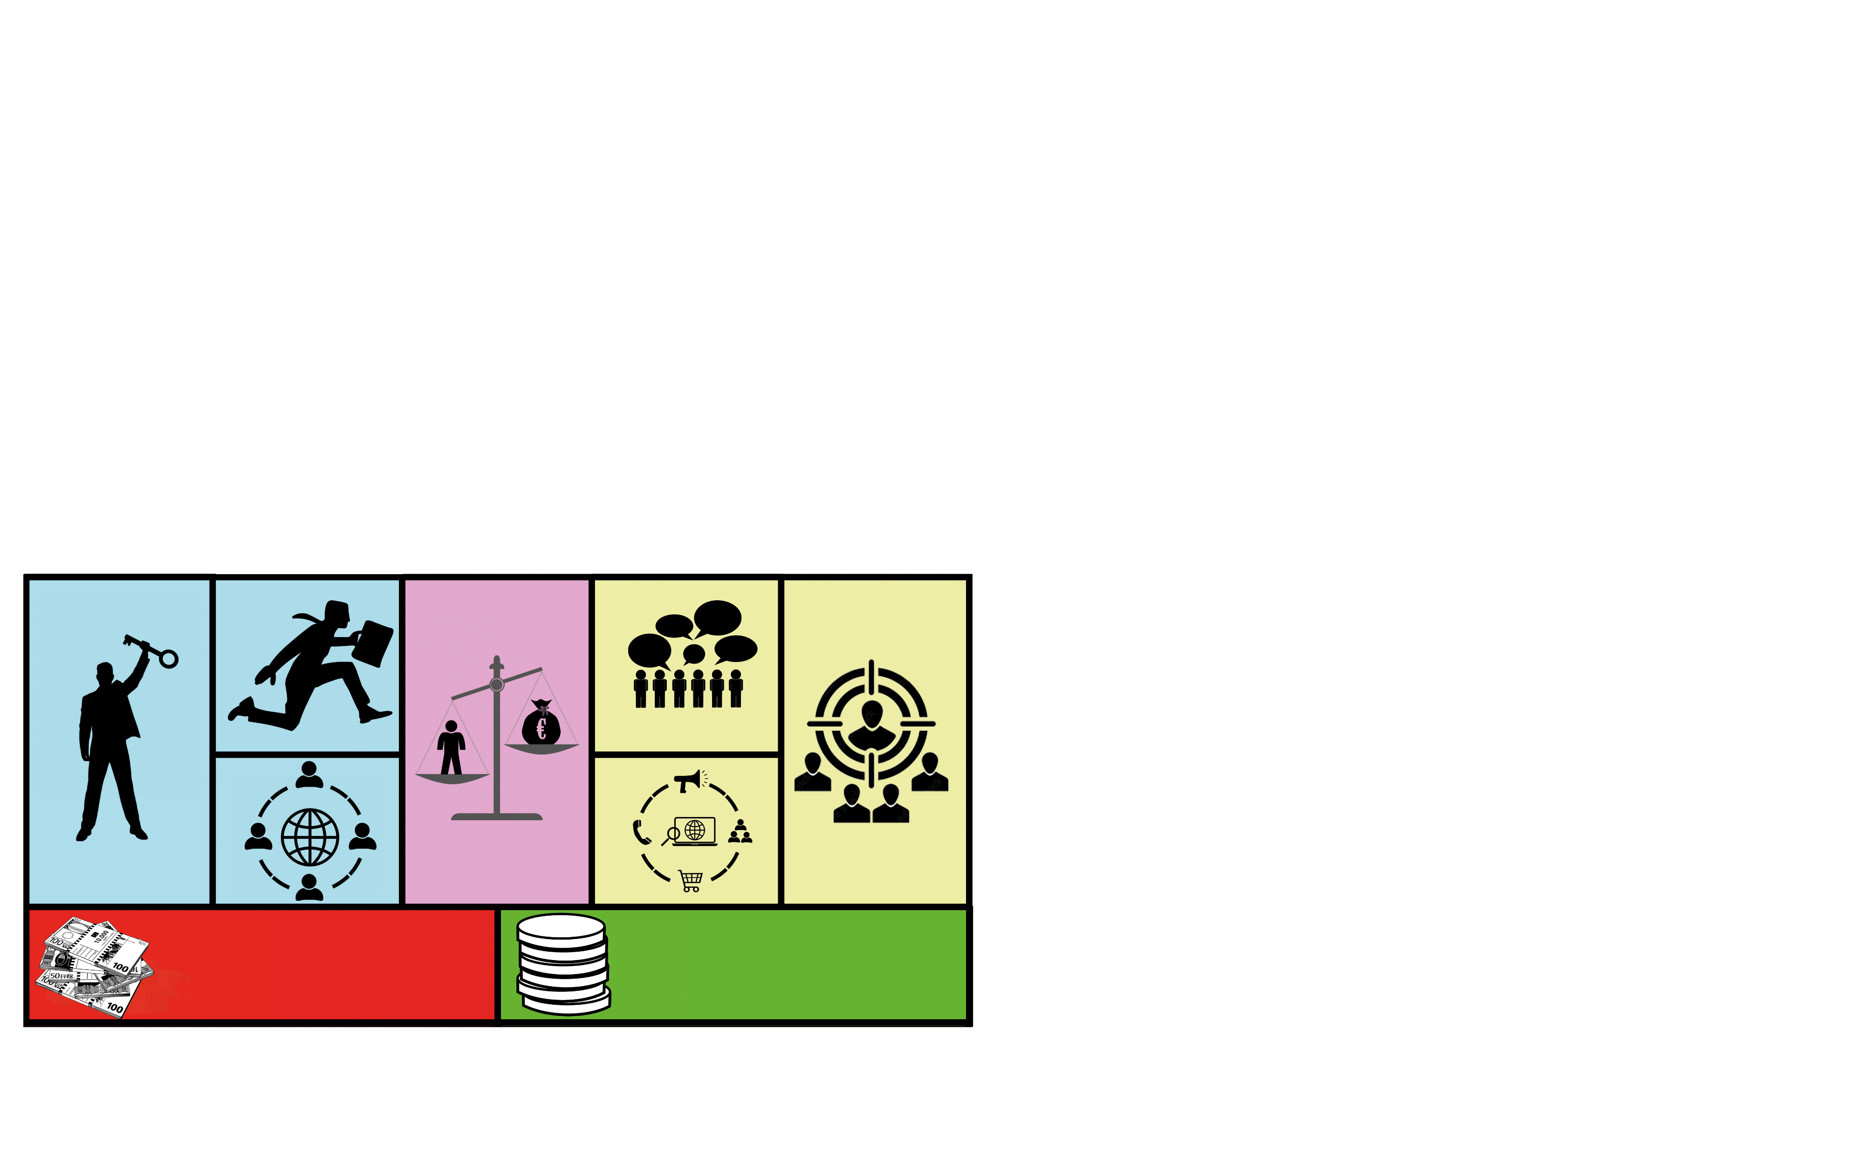
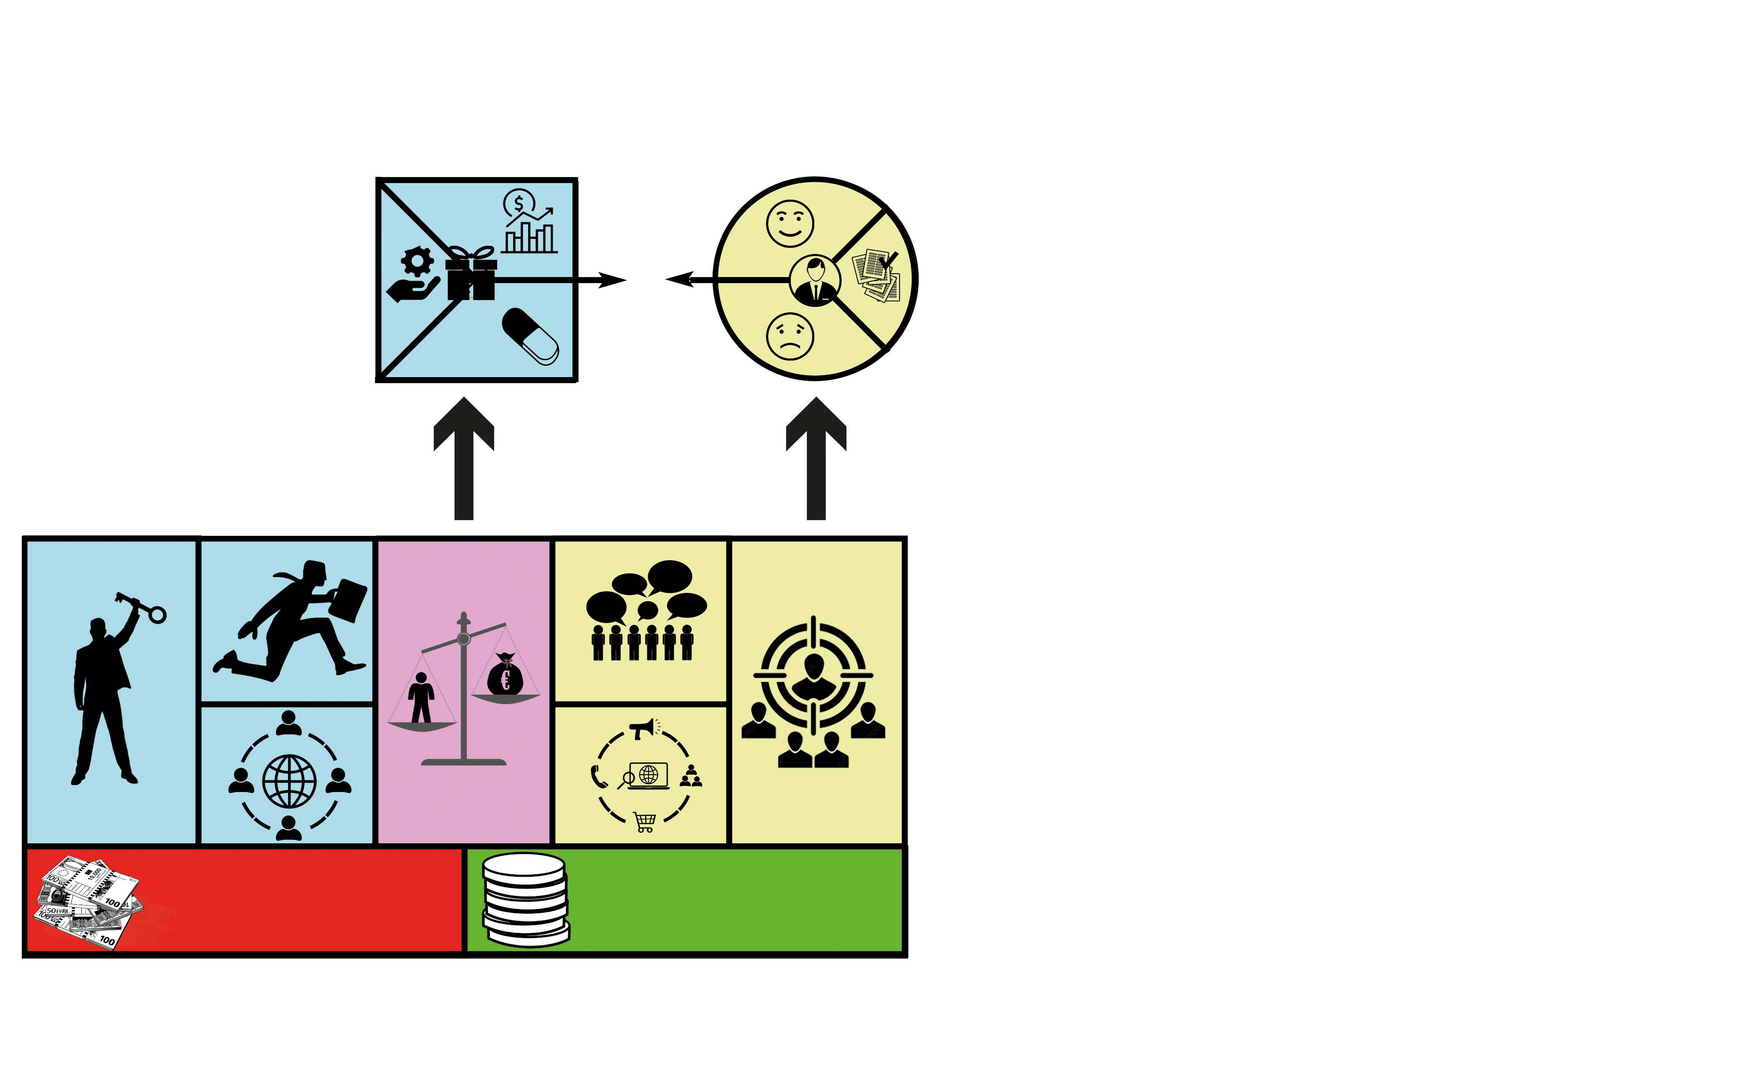
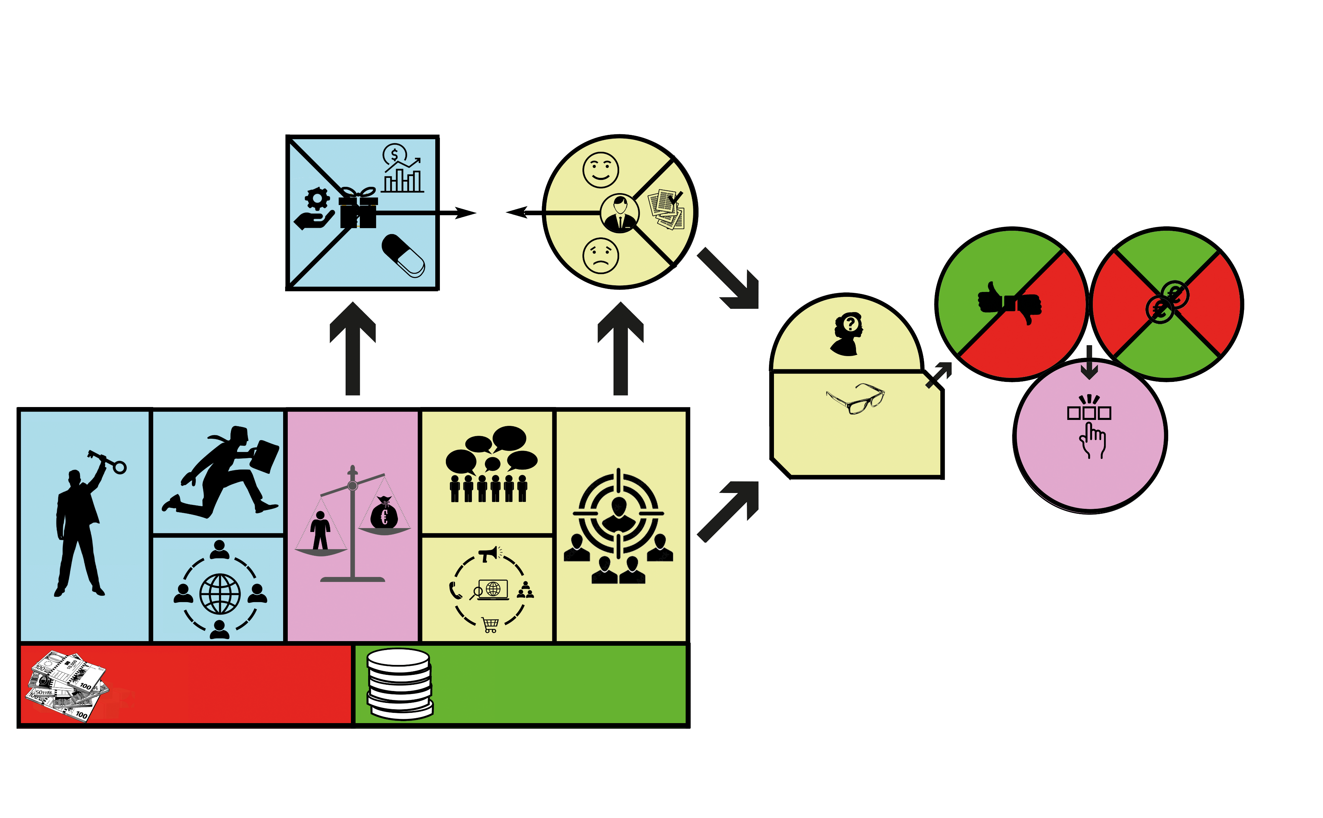
Working with models

Slide 5
What is financial literacy?
Discuss for 5 minutes with your neighbour
  Which financial mistakes did you make which could have been prevented?
  And what would have helped you to prevent those mistakes?
For me it is not only about literacy,
but also about empowerment

Slide 6


Literacy or empowerment
A person is financially empowered if he makes
well-considered choices in such a way that his finances
are balanced, both in the short and long term.
Financial literacy is simply about being knowledgeable. It means that you understand fundamental facts about money, such as the value of cash coins or bills. You also grasp standards and routine practices. A person who is financially literate also can apply the information he has, resulting in monetary gain

Slide 7
Literacy or empowerment
Financial literacy: all about accounting and using tools.
The outcome with the highest result is always the best!
Financial education is about using tools and accounting
WHAT DOES THAT MEAN FOR EDUCATION?
Financial empowerment: not just balancing your finances, but also geting the right information and knowing what is best for you!
Financial education is helping students to make well-considered decisions
For me my job as a teacher is to prepare students for the “real world”.

Slide 8



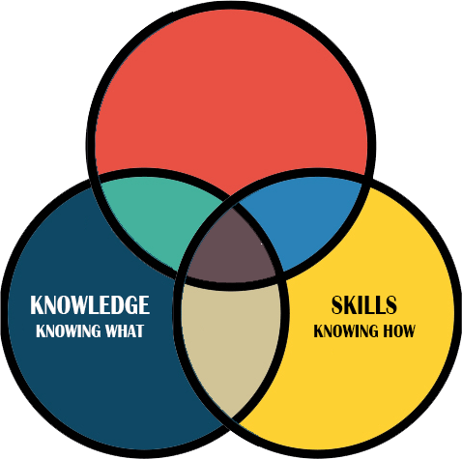
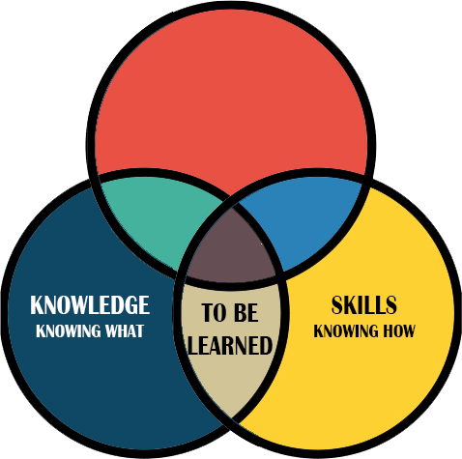
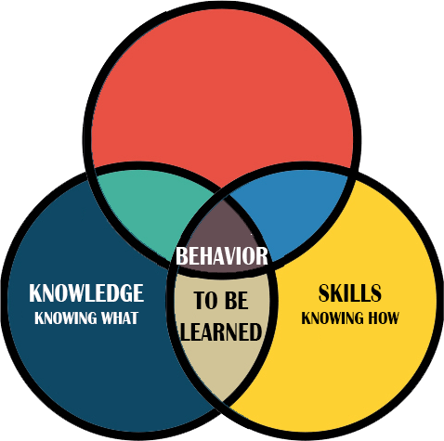
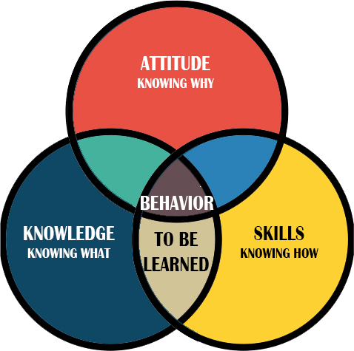
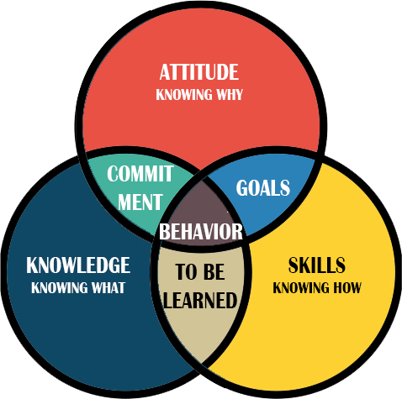
How to make well-considered choices
A person is financially empowered if he makes
well-considered choices in such a way that his finances
are balanced, both in the short and long term.
What do you need?
Knowledge
Skills
Attitude
This is what we call
Financial Literacy
Education??

Slide 9
What is financial literacy?
Discuss for 5 minutes with your neighbour
  Which financial mistakes did you make which could have been prevented?
  And what would have helped you to prevent those mistakes?
For me it is not only about literacy,
but also about empowerment

Slide 10




What to do?
We have to train our students to make well-considerated decisions
We have to prepare them for future behaviour
Just knowing is not enough
Just accounting is not enough
So we need case studies
And make them personal

Slide 11
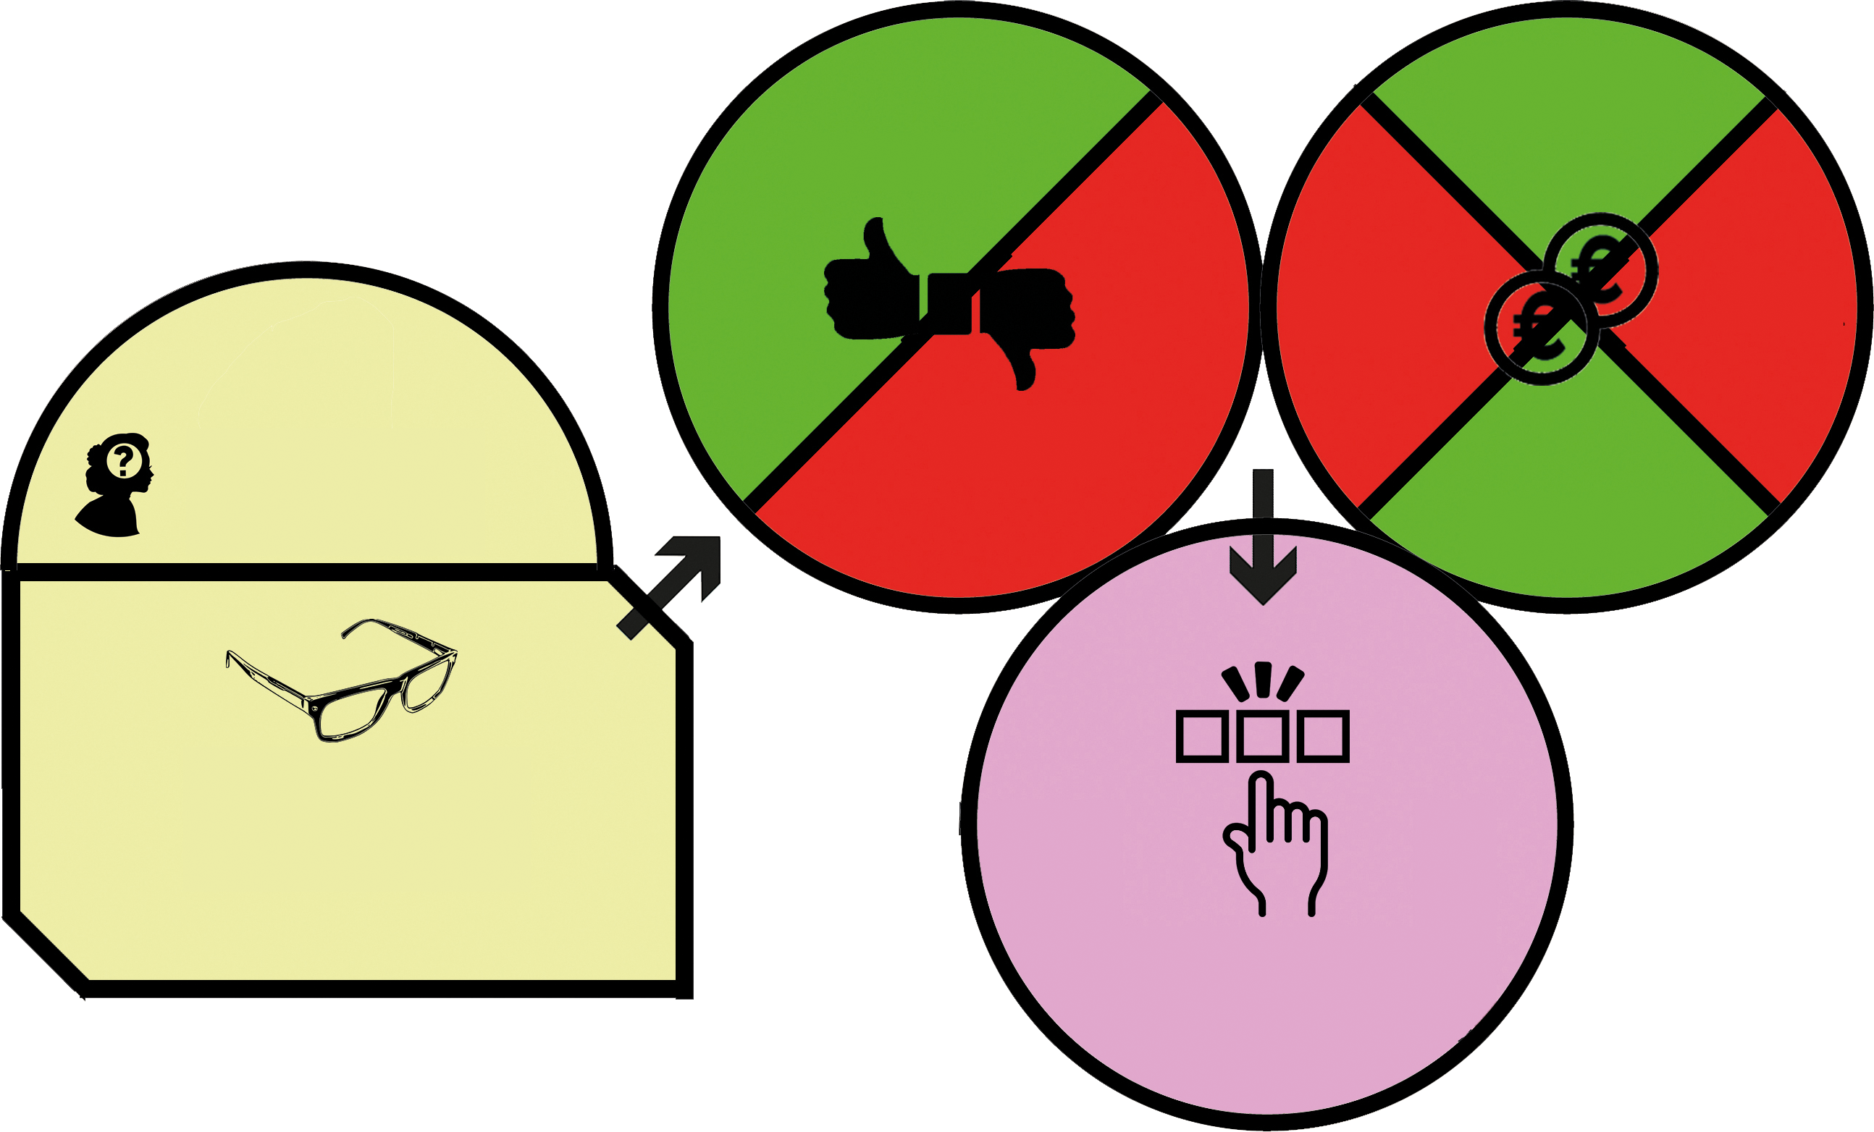
Use a model to attack a case
Make a case personal. A student learns the most if he or she answers on his own behalf. These decisions to make affect him or her directly.
Every case starts with a question/problem/challenge.
The first step to make is to decide what you know about the problem and what you have to know about (solving) the problem.
Based on the obtained knowledge (charasteristics) a student defines his own advantages and disadvantages
Based on the obtained skills a student can make a financial assessment based on costs, income, revenues and expenditures
At last a student can make a solid decisions based on knowledge, advantages, disadvantages and skills

Slide 12

Advantages
What advantages and
disadvantages do YOU
see based on the
charasteristics
Receipts
Costs
FINANCIAL
CALCULATIONS
Expenses
What is YOUR problem?
What question do YOU
have to answer?
Disadvantages
Earnings
KNOWLEDGE - Charesteristics
What do YOU know?
What do YOU need to know?
Find or check
theoretical background
Well-considered decision
Based on
YOUR Knowledge
YOUR (dis)advanteges
YOUR financial skills

Slide 13


Slide 14
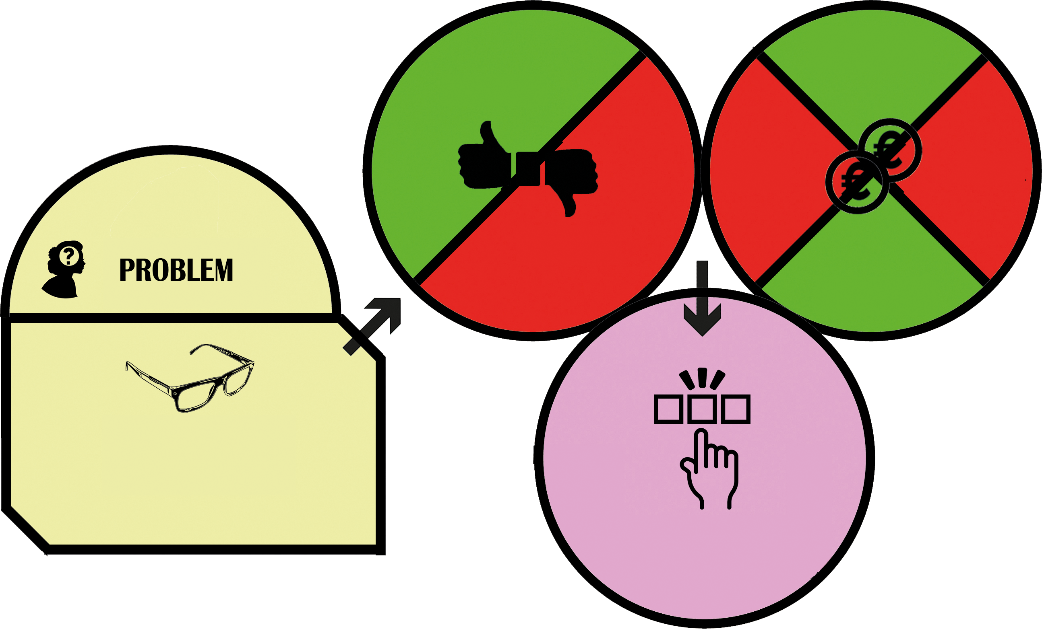
How do I finance MY study

Slide 15
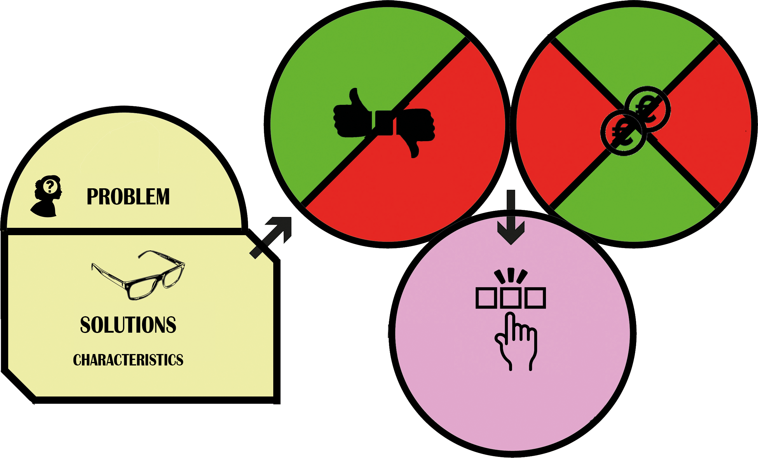
How do I finance MY study
What are the costs of my study?
Save, Loan or Invest?
Save – Simple or compound interest?
Loan – Linear or annuity?
Invest – Stocks, debentures or options?

Slide 16
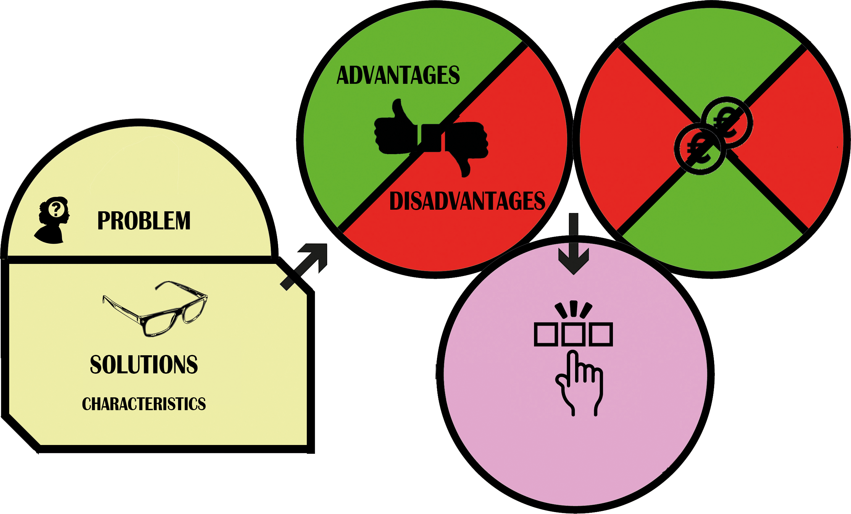
Be aware of merging advantages
and disadvantages on the one
hand and on the other hand
the charactereristics
How do I finance MY study
What are the costs of my study?
Save, Loan or Invest?
Save – Simple or compound interest?
Loan – Linear or annuity?
Invest – Stocks, debentures or options?

Slide 17
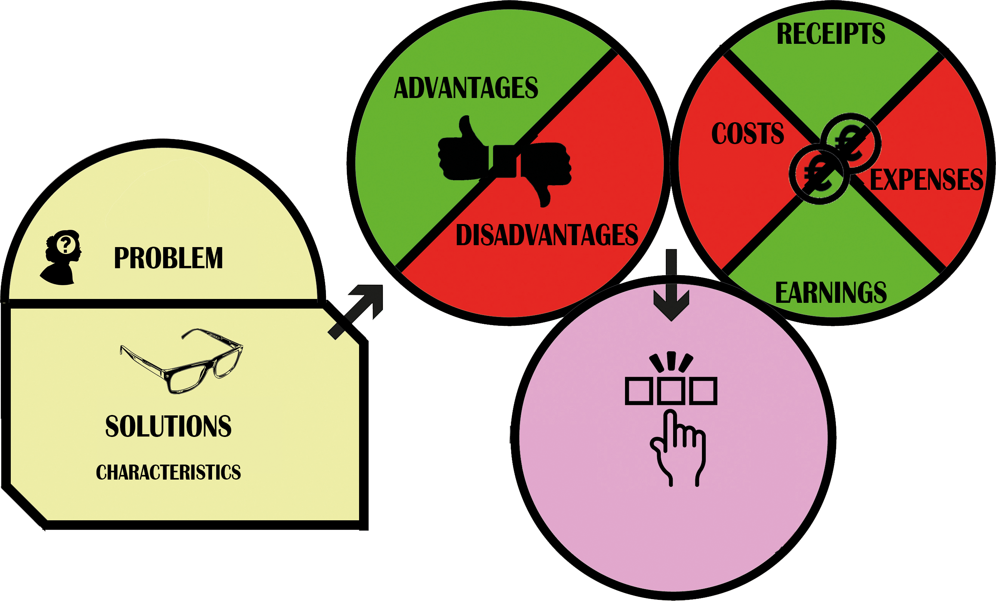
Monthly during
study
Be aware of merging advantages
and disadvantages on the one
hand and on the other hand
the charactereristics
As from now
monthly
payments
SAVE
How do I finance MY study
Earned
interest
What are the costs of my study?
Save, Loan or Invest?
Save – Simple or compound interest?
Loan – Linear or annuity?
Invest – Stocks, debentures or options?

Slide 18
Monthly during
study
Be aware of merging advantages
and disadvantages on the one
hand and on the other hand
the charactereristics
Monthly
payments
after study
Paid
interest
LOAN
How do I finance MY study
What are the costs of my study?
Save, Loan or Invest?
Save – Simple or compound interest?
Loan – Linear or annuity?
Invest – Stocks, debentures or options?

Slide 19
Monthly during
study (estitmate)
Be aware of merging advantages
and disadvantages on the one
hand and on the other hand
the charactereristics
Estimated
payments
as from now
Paid
provision
INVEST
How do I finance MY study
Estimated
earnings
What are the costs of my study?
Save, Loan or Invest?
Save – Simple or compound interest?
Loan – Linear or annuity?
Invest – Stocks, debentures or options?

Slide 20


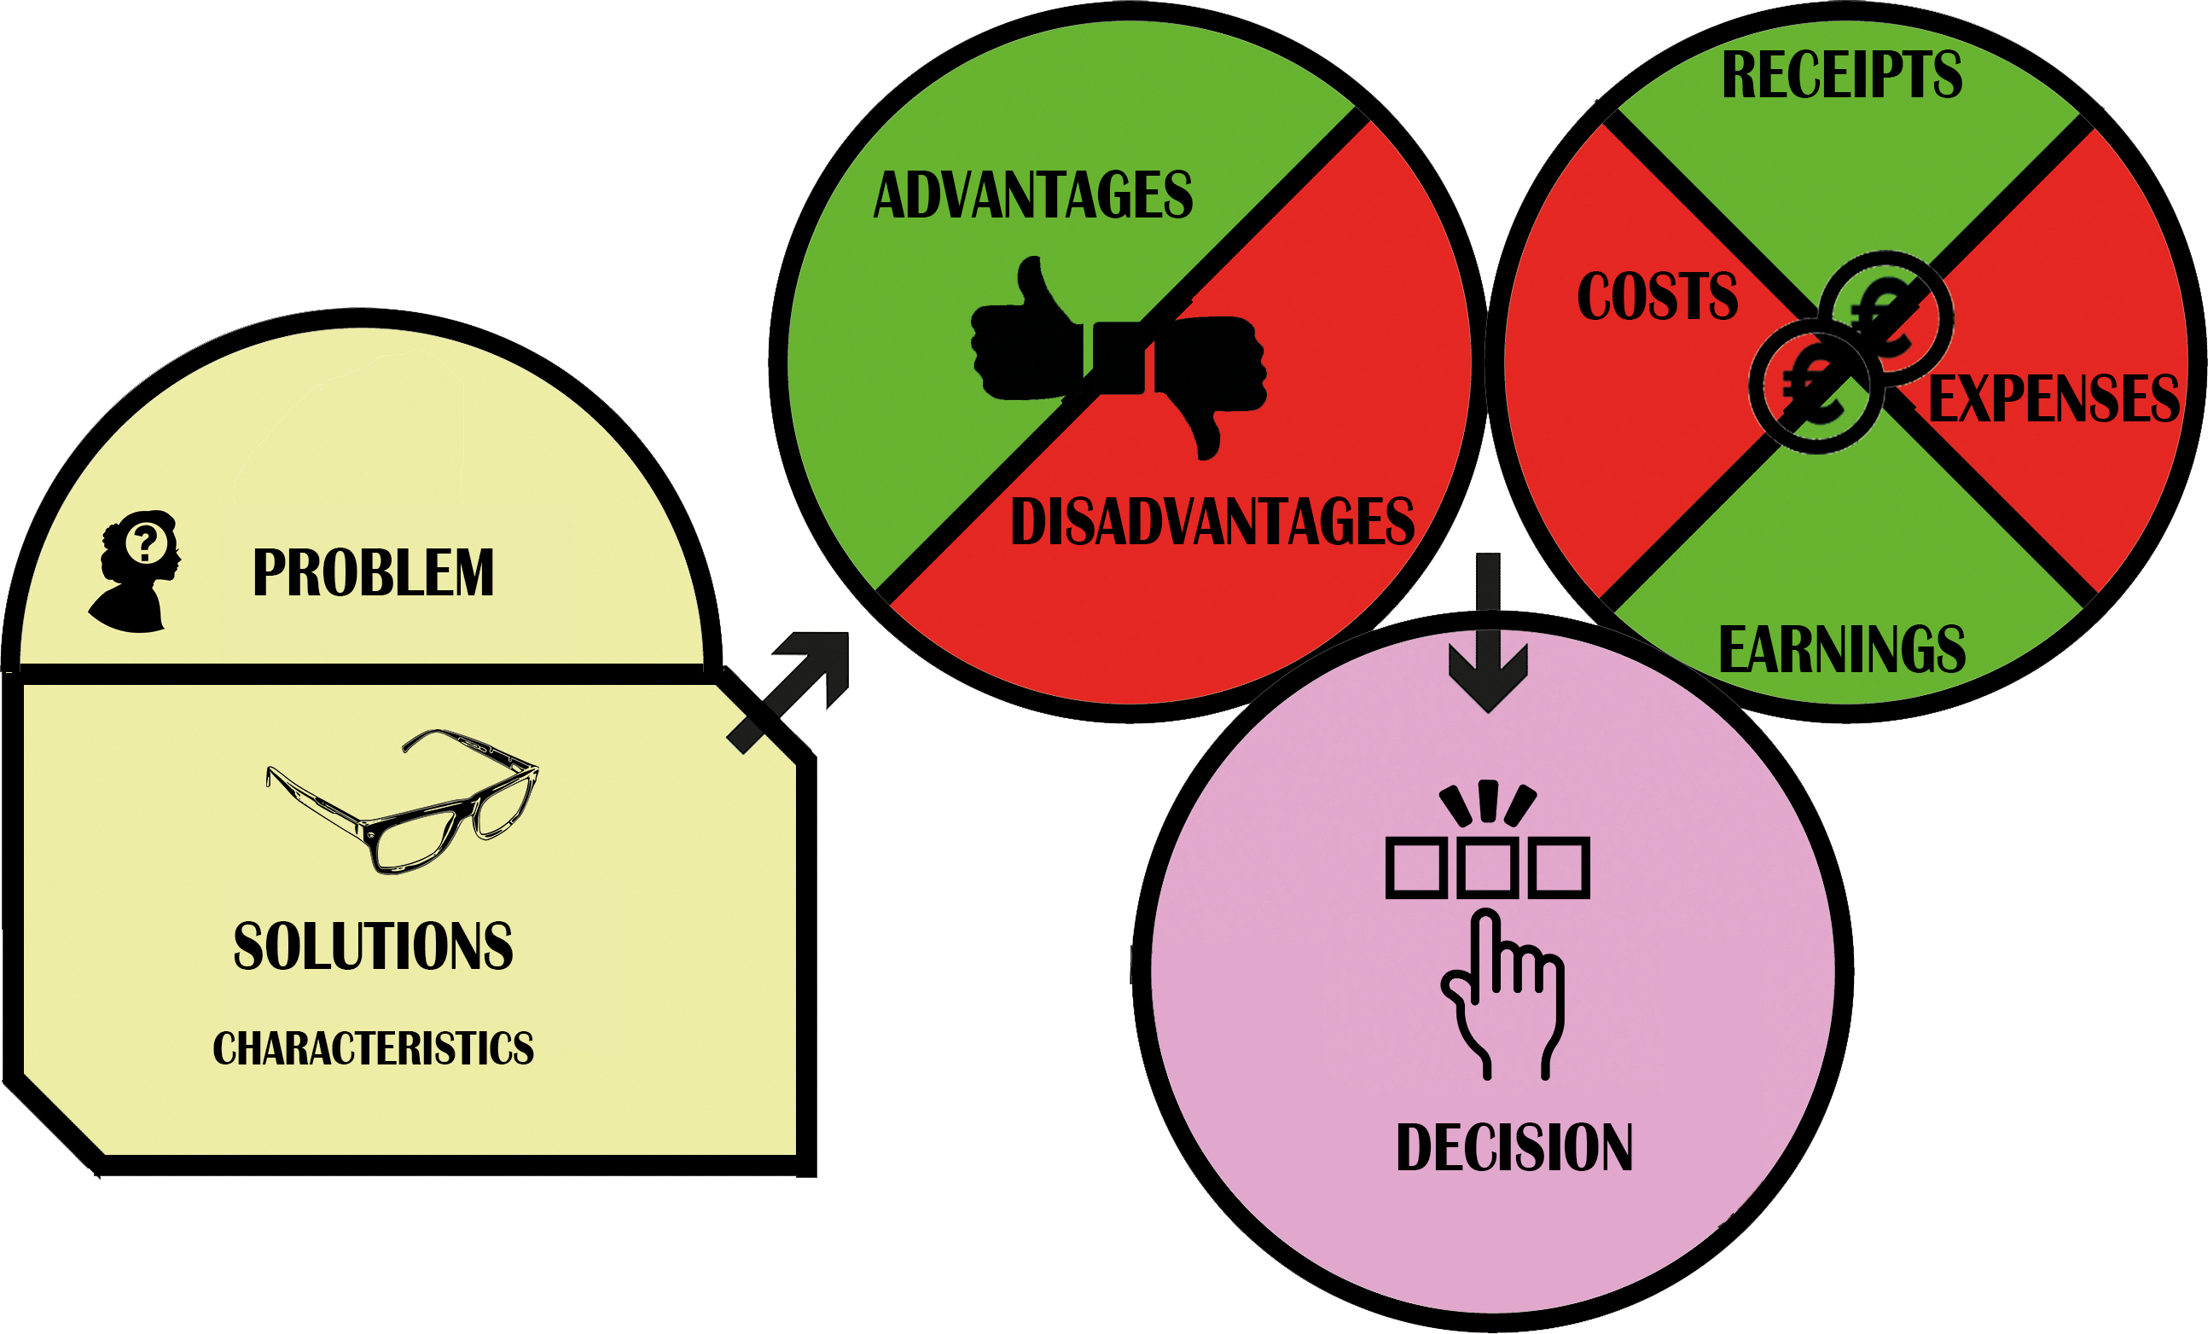
Be aware of merging advantages
and disadvantages on the one
hand and on the other hand
the charactereristics
How do I finance MY study
What are the costs of my study?
Save, Loan or Invest?
Advantages
Disadvantages,
Financials
Which are
important
and why
Save – Simple or compound interest?
Loan – Linear or annuity?
Invest – Stocks, debentures or options?

Slide 21

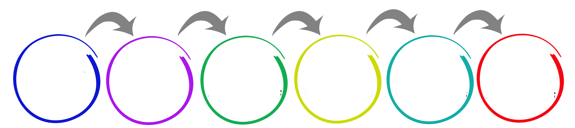
Be aware of merging advantages
and disadvantages on the one
hand and on the other hand
the charactereristics
How do I finance MY study
What are the costs of my study?
Save, Loan or Invest?
Advantages
Disadvantages,
Financials
Which are
important
and why
Save – Simple or compound interest?
Loan – Linear or annuity?
Invest – Stocks, debentures or options?

Slide 22
What do we need?
Resources on costs of study
Theory, exercise materials and learning formats on saving
Theory, exercise materials and learning formats on loans
Theory, exercise materials and learning formats on investing

Slide 23
Financial empowerment
It is not about the decision, it is about the process
Decisions are not subject to grading
Any well-considered decision is okay
Financial literacy: all about accounting and using tools.
The outcome with the highest result is always the best!
Financial literacy: all about accounting and using tools.
The outcome with the highest result is always the best!
Financial empowerment: not just balancing your finances, but also geting the right information and knowing what is best for you!
Financial empowerment: not just balancing your finances, but also geting the right information and knowing what is best for you!

Slide 24

Questions?

